Slide 1
Sandymount dodder wheelers 2021 AGM

Slide 2
Sandymount Dodder Wheelers 2021 AGM
Agenda
Welcome from the President Gerard Cahillane and Chairperson Thomas Davy
Minutes of last AGM
Matters Arising
Season 2021 report by Chairperson Thomas Davy
Report on 2021 Accounts by Treasurer Lisa Fagan
Proposed programme for 2022 by President Gerard Cahillane
Subscription fee for next season
Election of officers for next season
Any other business
Housekeeping
Please ensure your device has your name
Please remain on mute unless asking a question
Please raise your virtual hand to ask a question
The AGM is being recorded for minuting & sharing with members

Slide 3
2021 season report

Slide 4
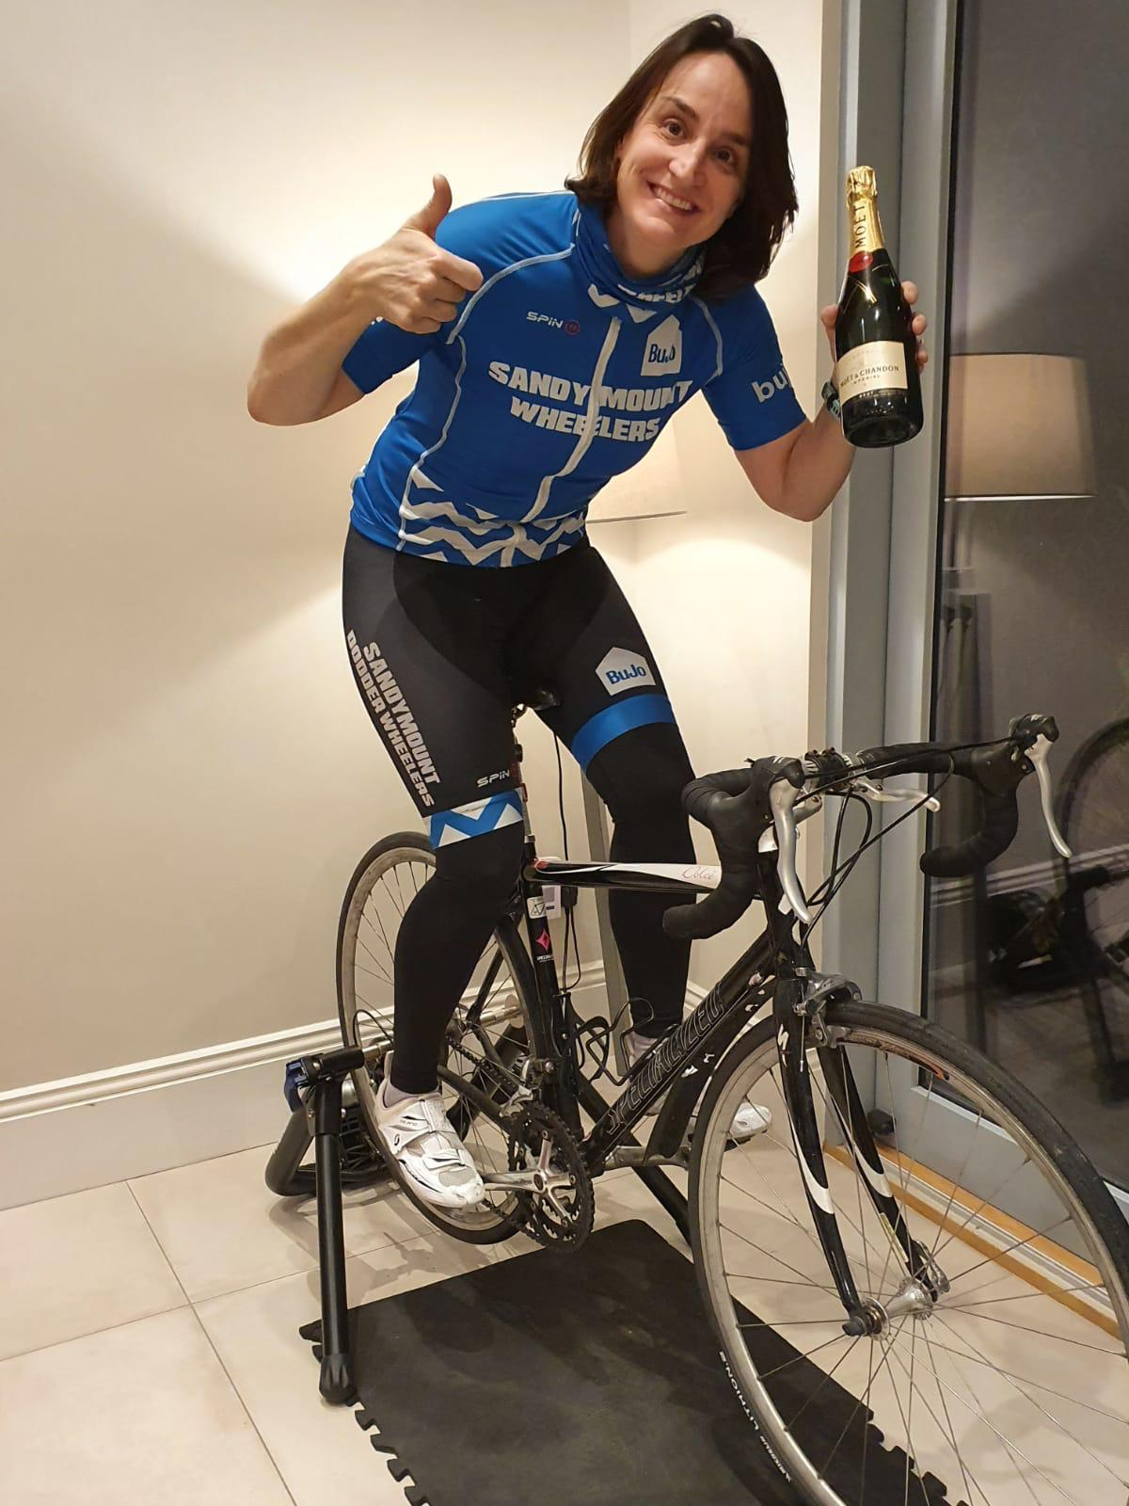
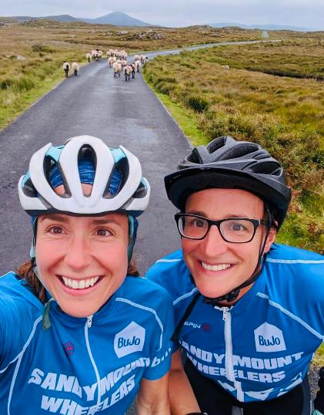
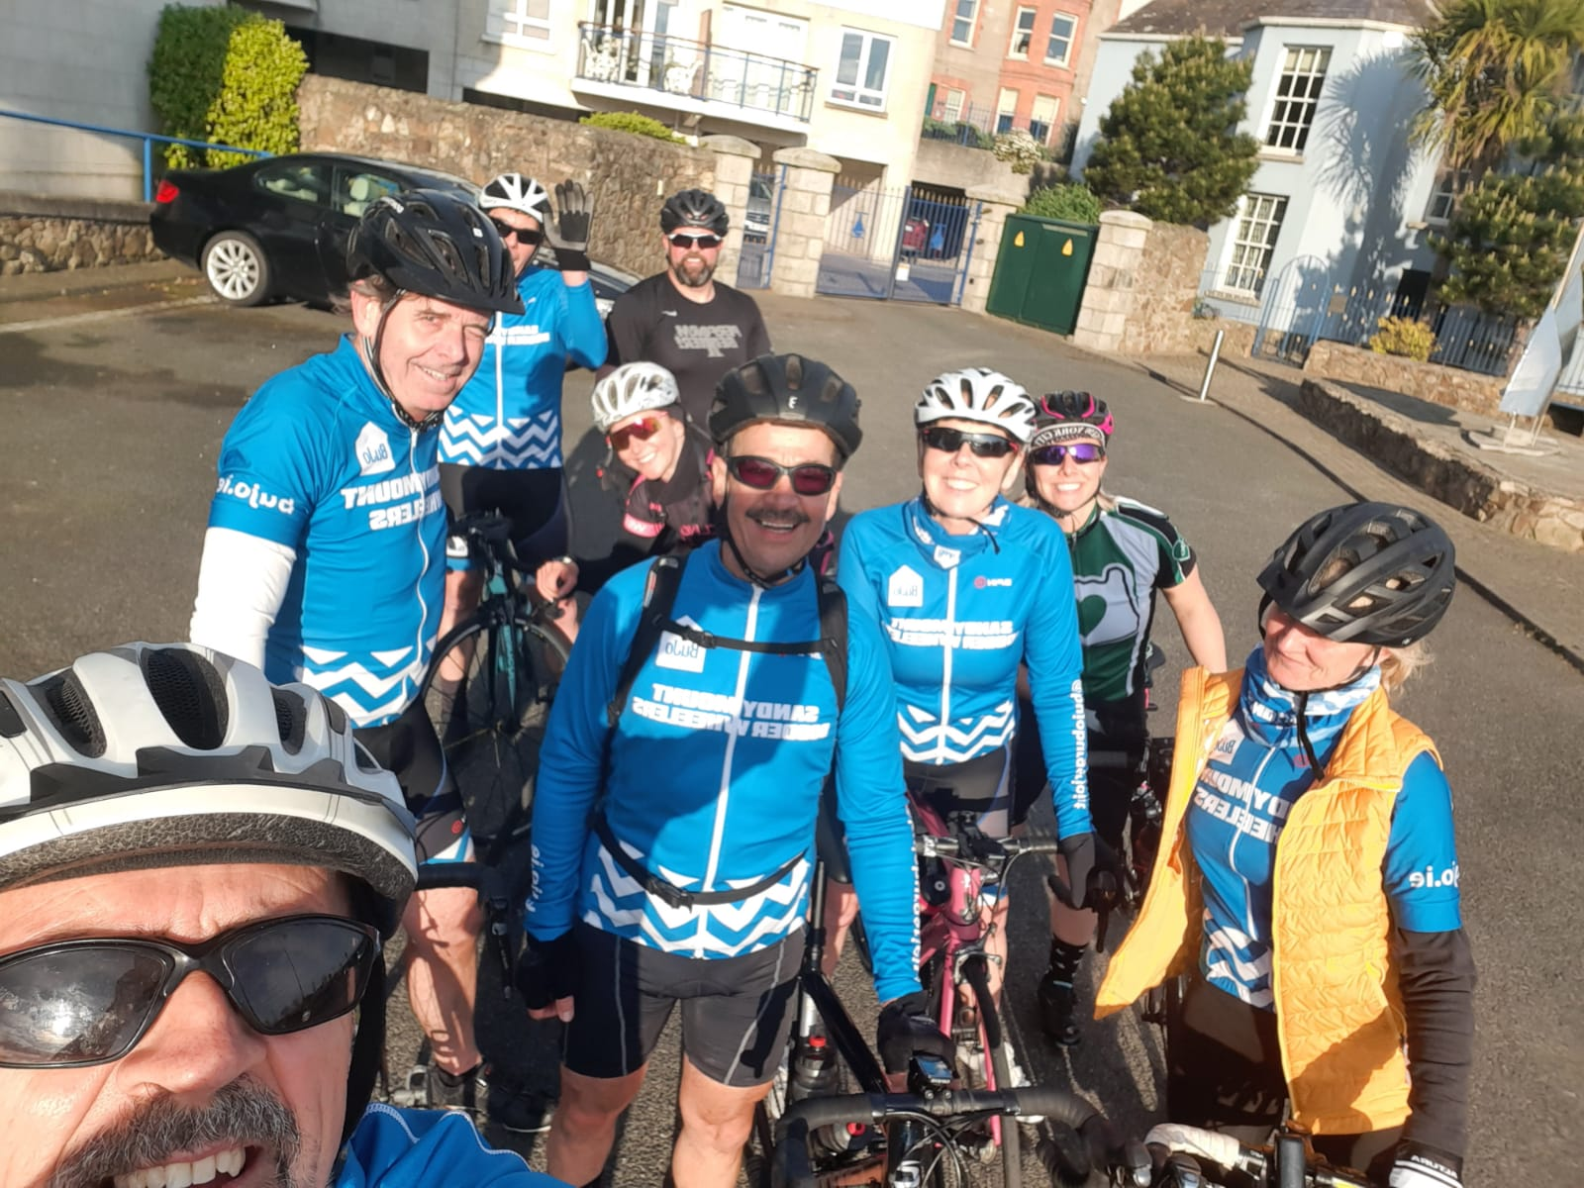
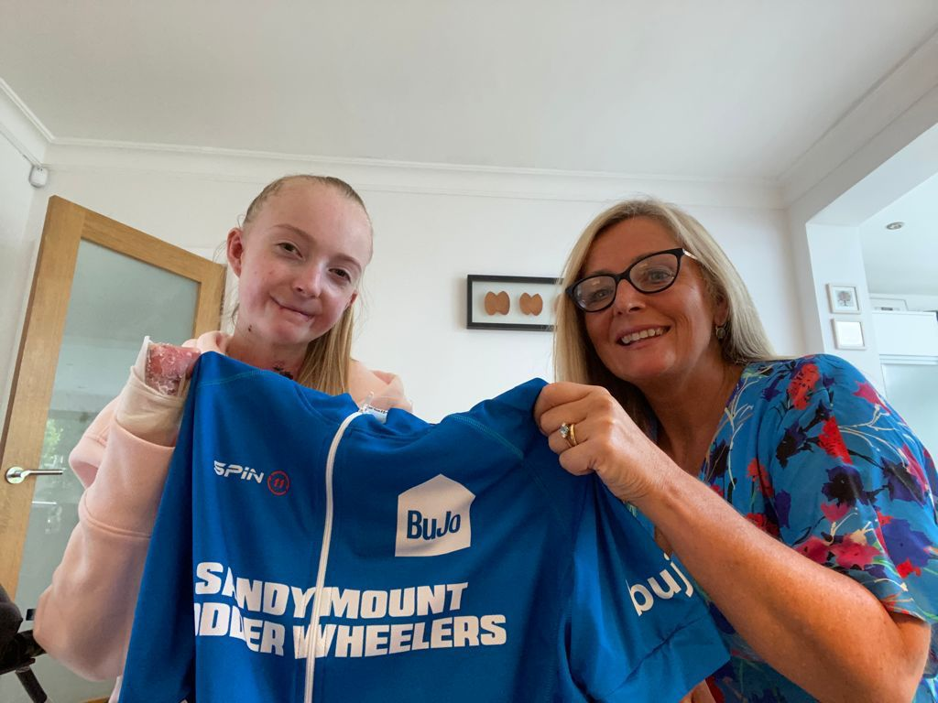
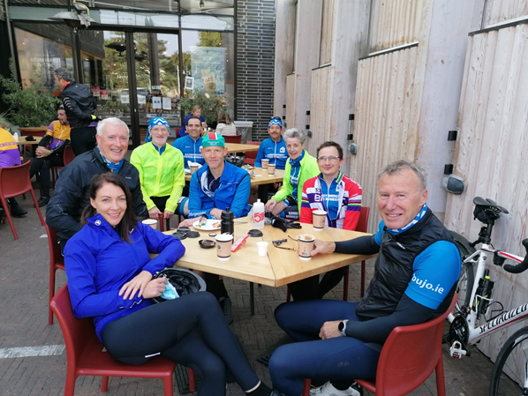
2021 season report

Slide 5
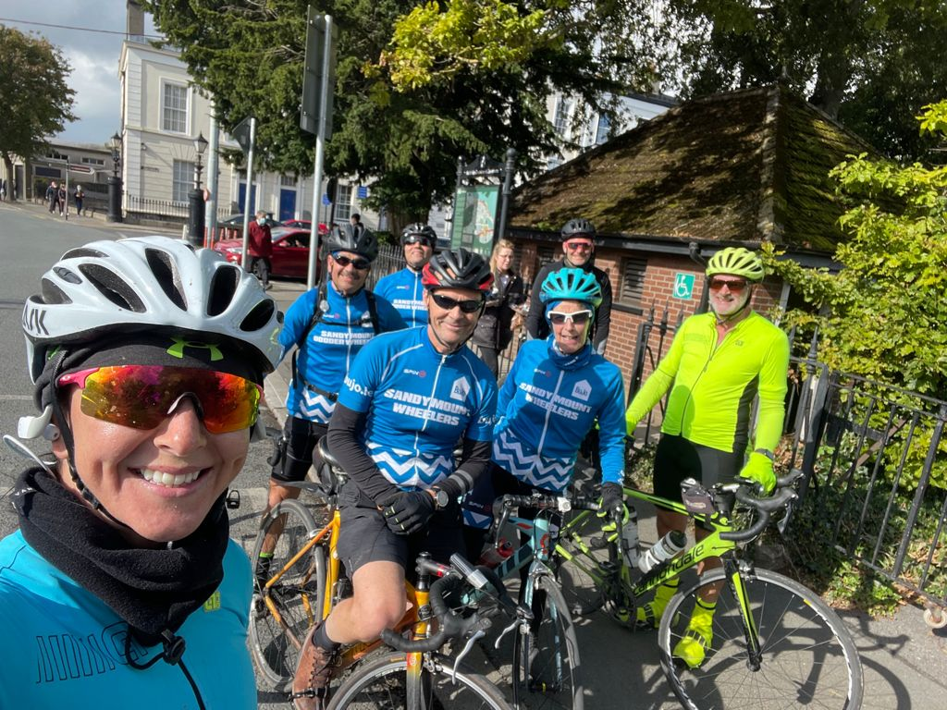
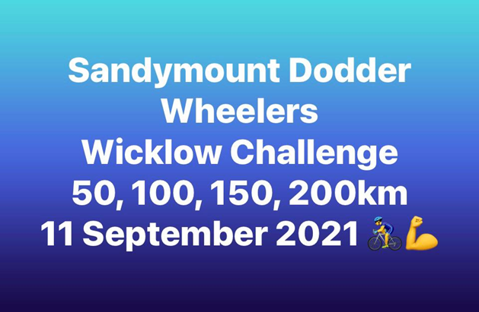
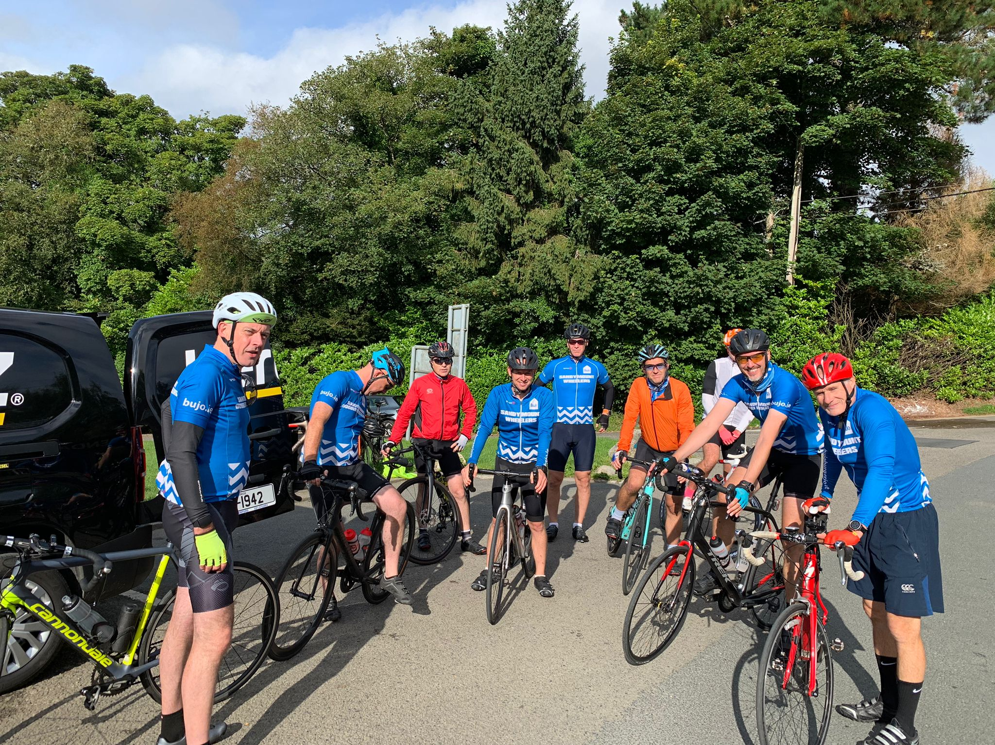
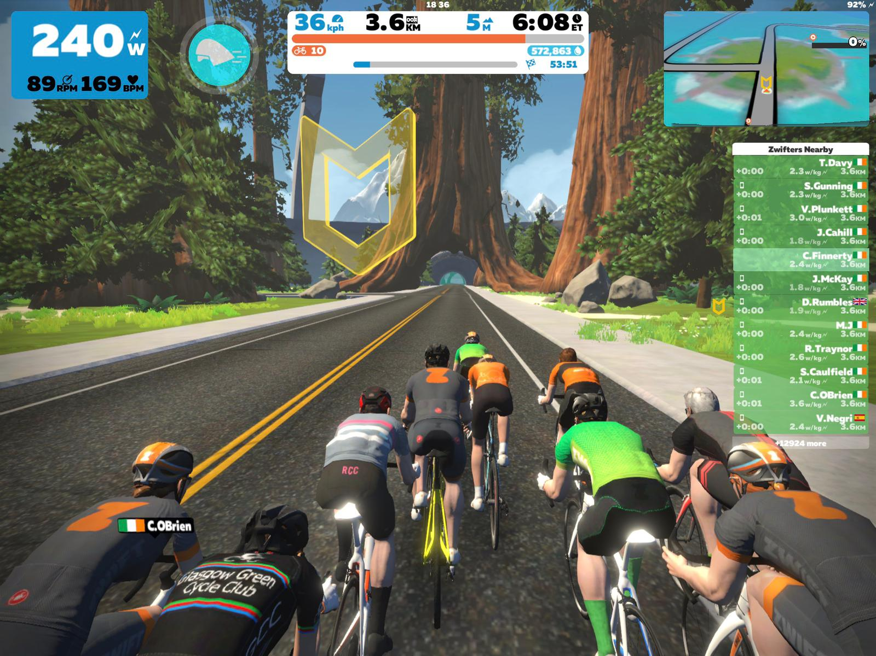
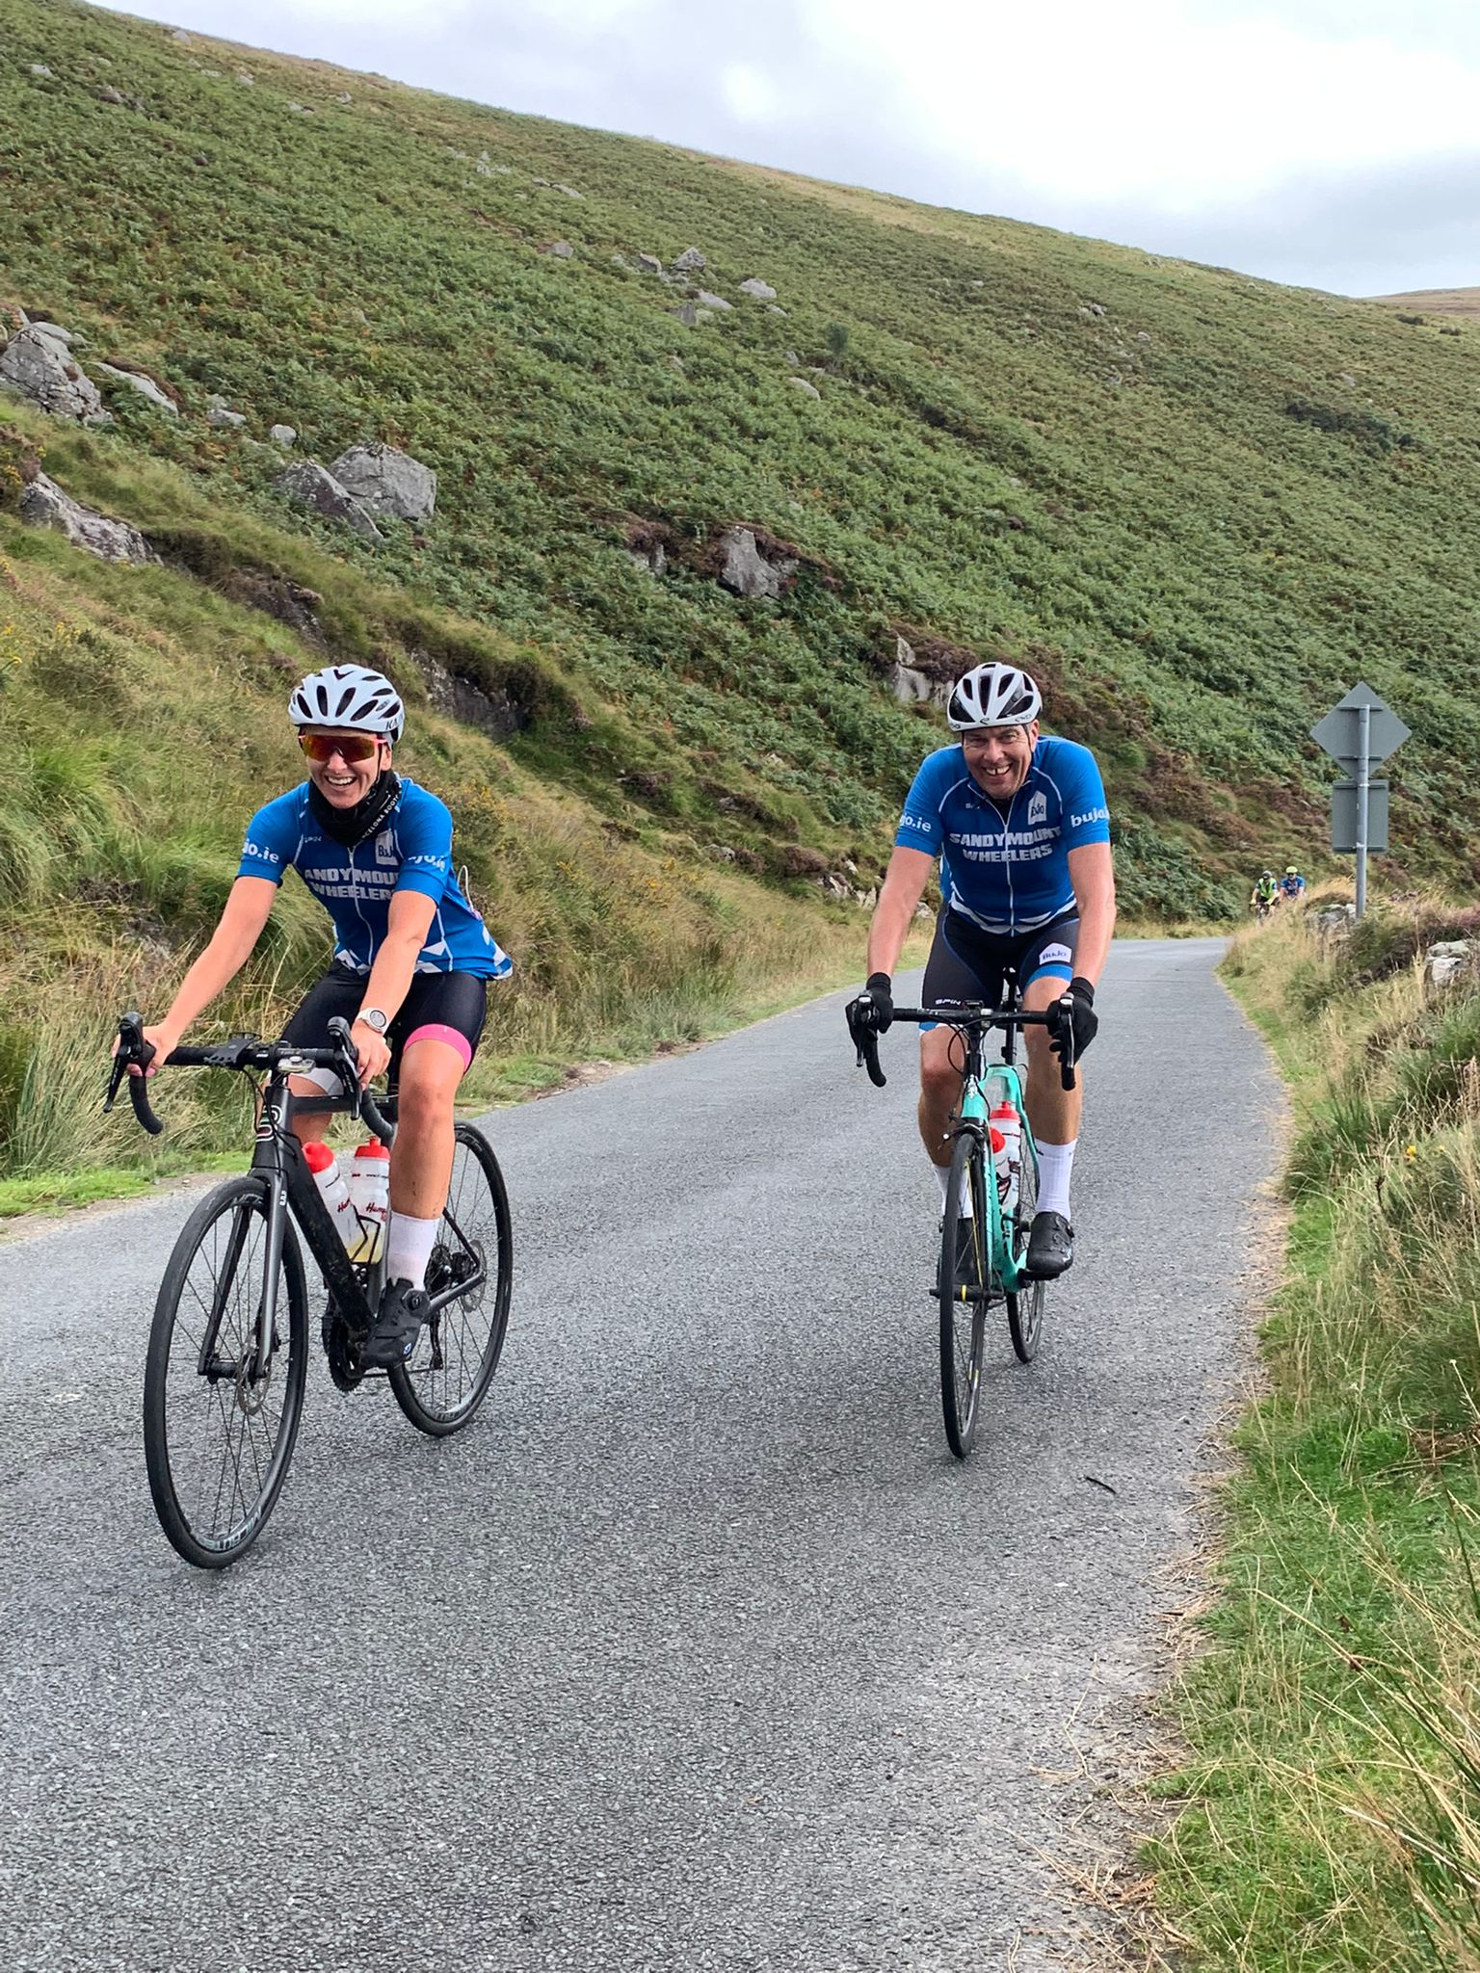
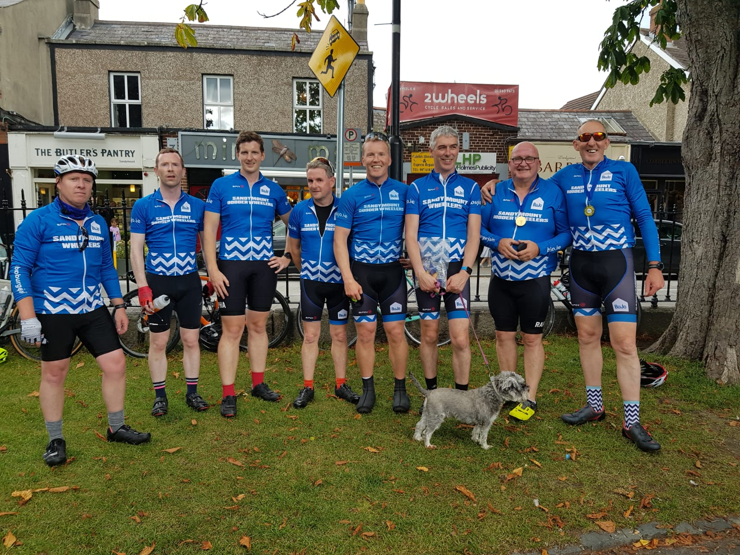
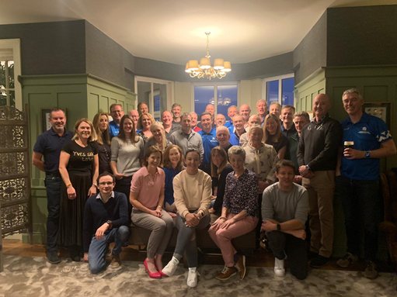
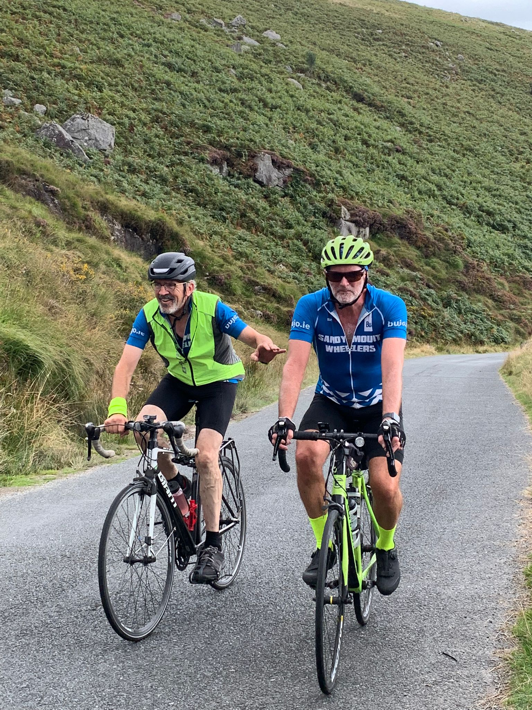
2021 season report

Slide 6
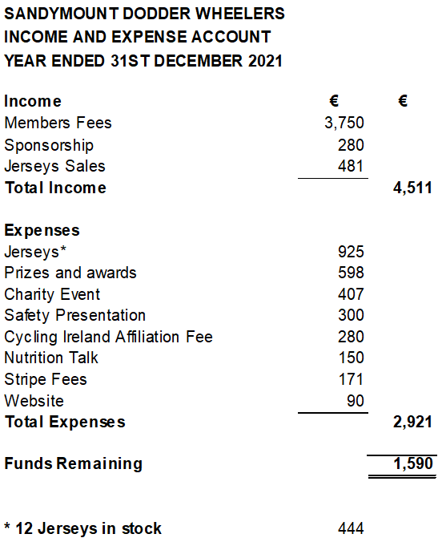
Sandymount Dodder Wheelers
Report on 2021 Accounts

